Slide 1
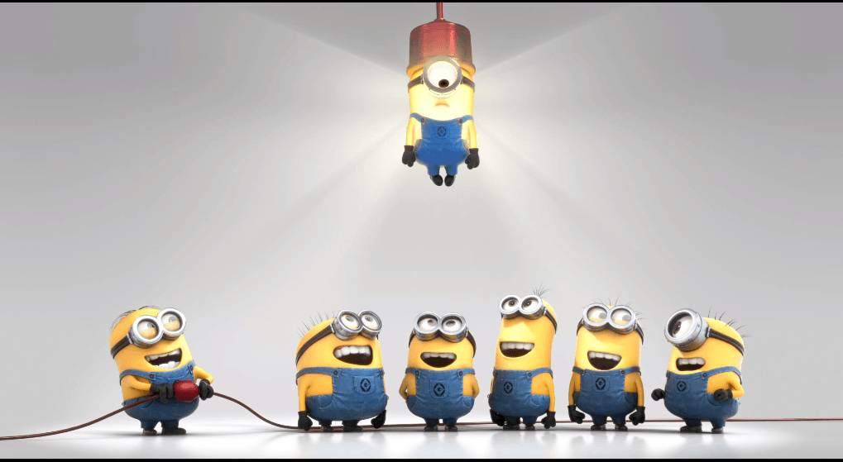
WELCOME

Slide 2
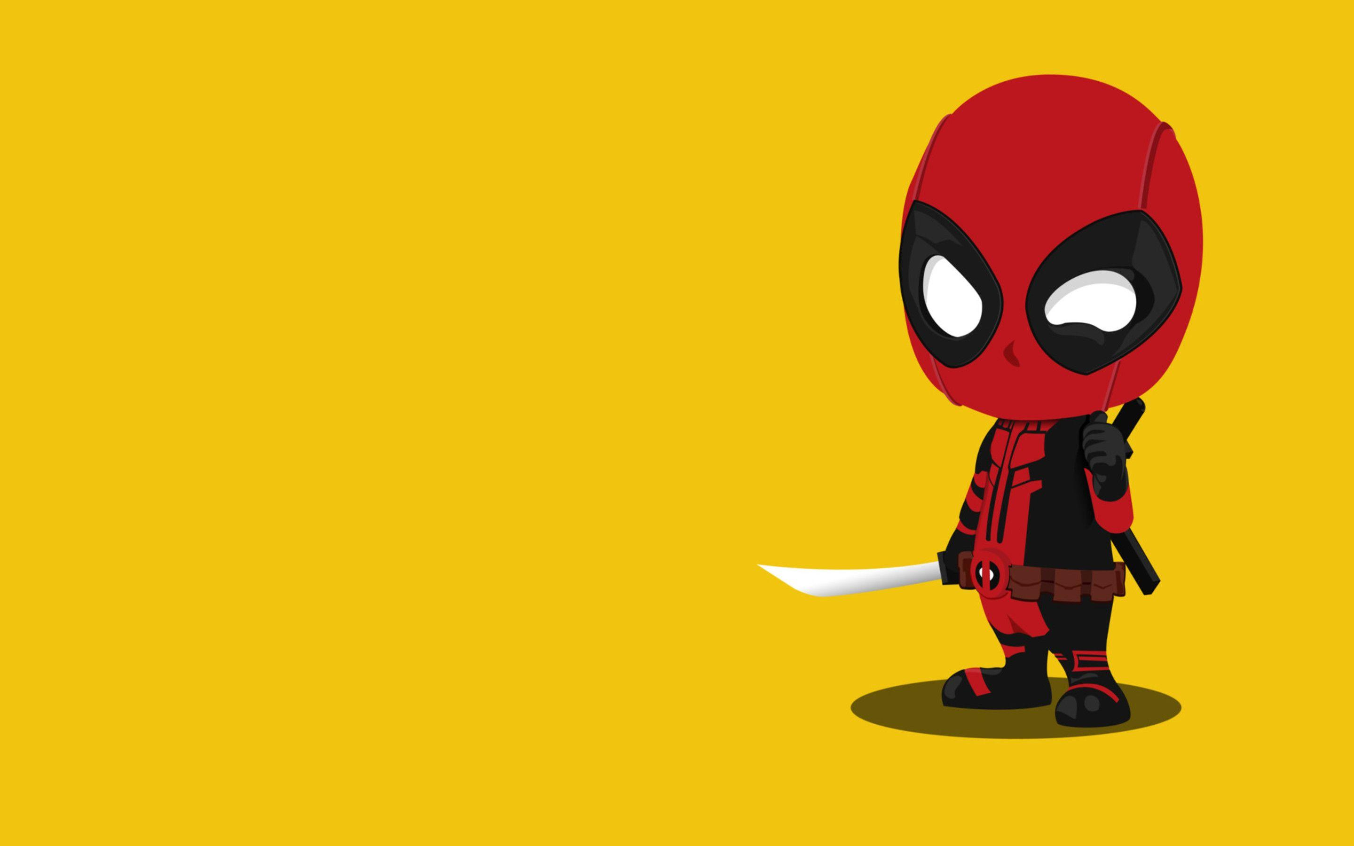
Toon translator
Our Team :
Sahil Borse
Arpita Pawar
Rohan Noronha
Ganesh Mali
Ramchandra Potadar
Shabnam Pathan
Guided By : Prof. Supriya Indore

Slide 3
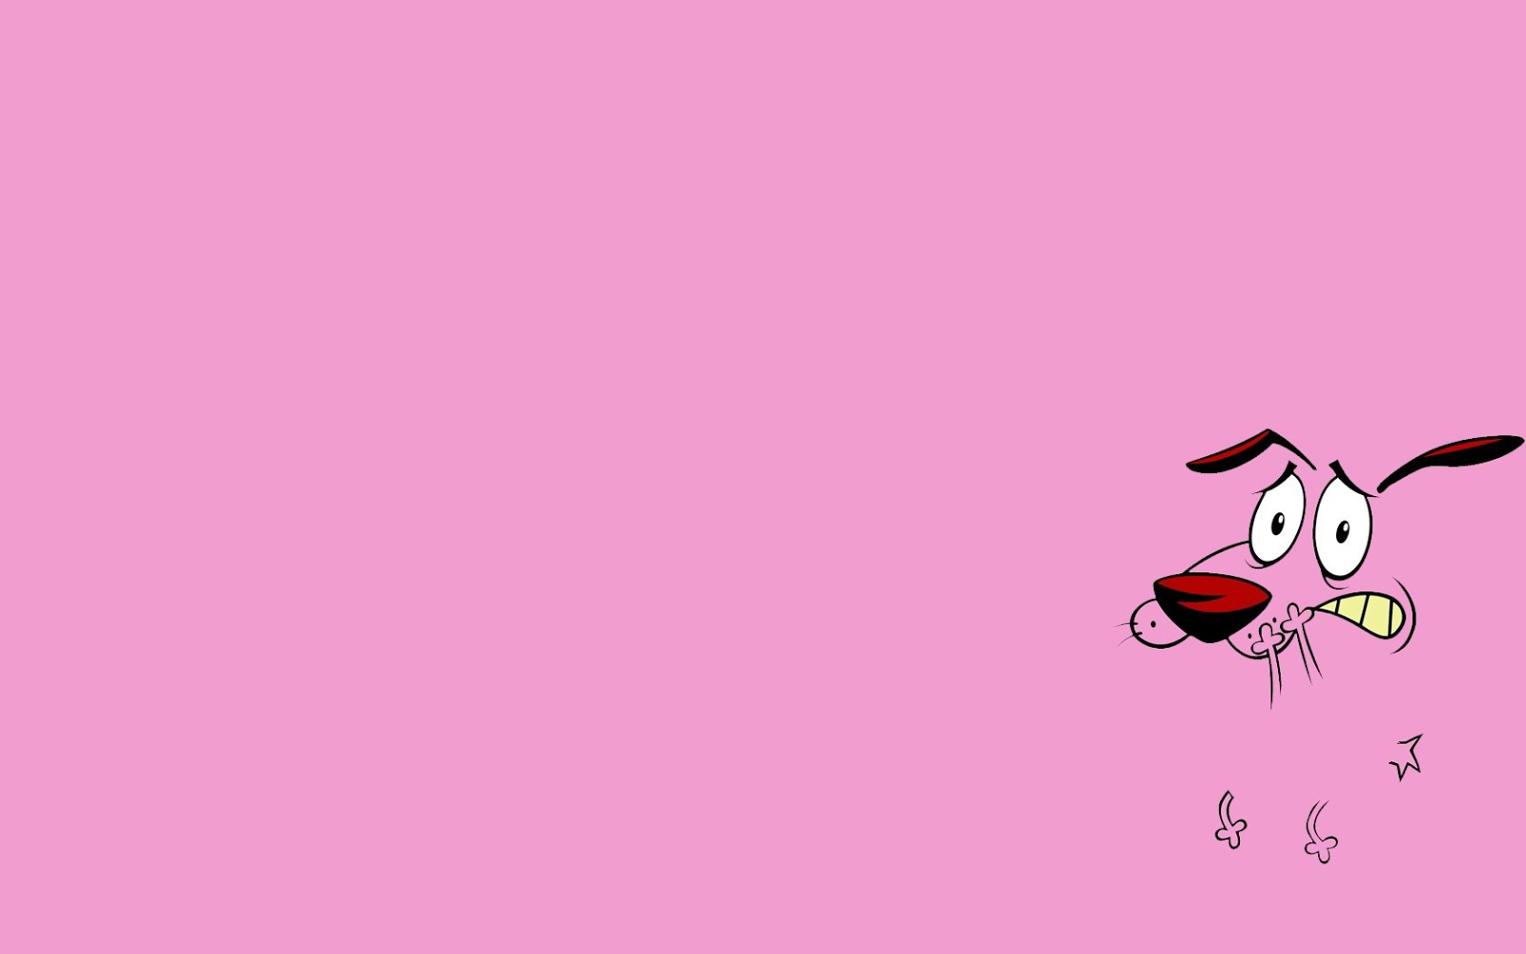
Problem statement :
Creating a fun WebApp which can Translate Funny Fictional Languages Like Banana, Groot, Dolan and Navi.
Creating a WebApp which may provide some fun Tag Lines to Advertise your Product.

Slide 4
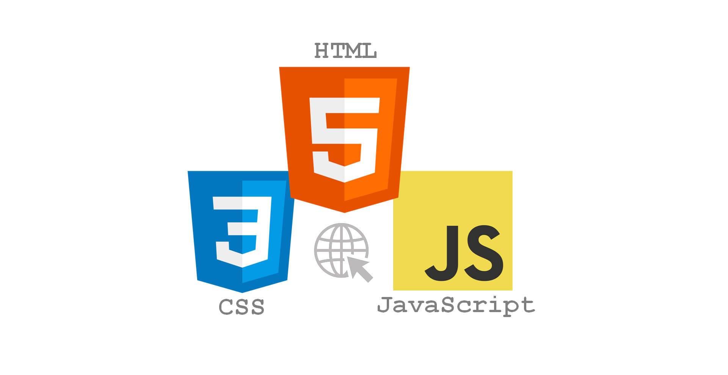
Languages used :

Slide 5
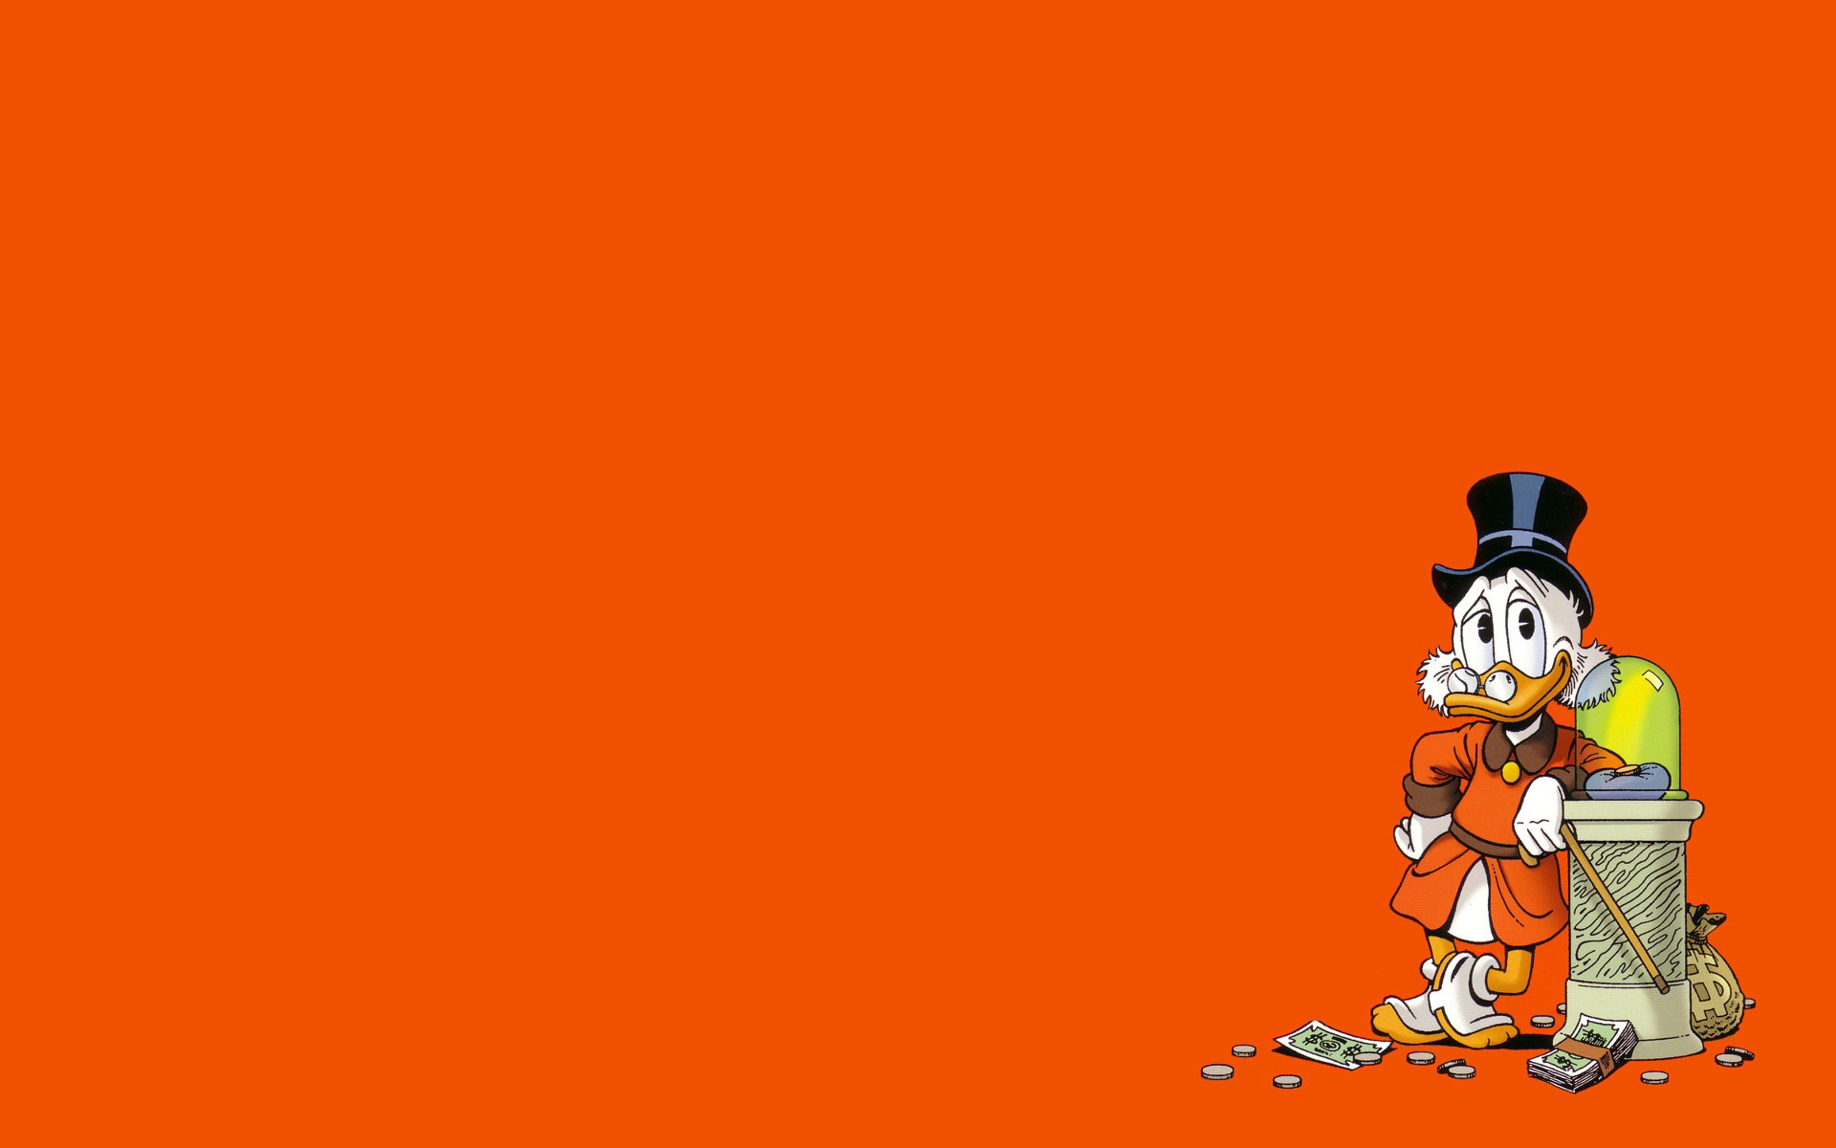
Objective:
Enables language accessibility, allowing people to understand and enjoy regardless of language barriers.
Humour in cartoon accessible to global audience.
Adapt jokes, wordplay, and cultural references for the target audience.
Allow viewers to experience the same emotions and entertainment as the original audience.
Ensure relatability and entertainment by considering cultural differences and context.

Slide 6
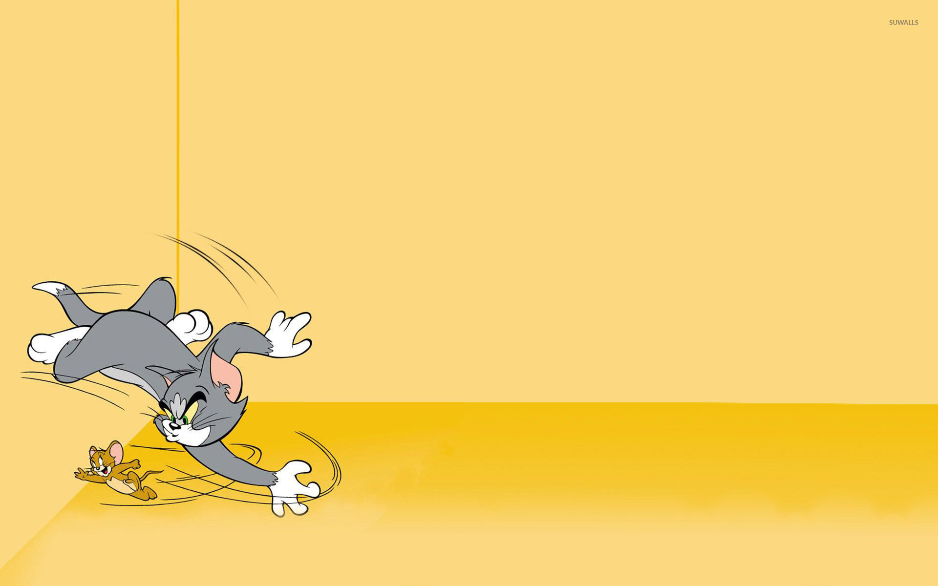
Programming Languages and Functionality in the Project:
When working on a project, it is essential to choose the right programming languages and utilize appropriate functions and tags to achieve the desired functionality.
So, for this project we used HTML(hyper text markup language), CSS(cascading style sheets) and java script.
- HTML: The standard markup language for creating the structure of web pages.
- CSS: The style sheet language used for defining the visual appearance of the translator application.
- JavaScript: The high-level programming language responsible for interactivity and functional behavior.

Slide 7
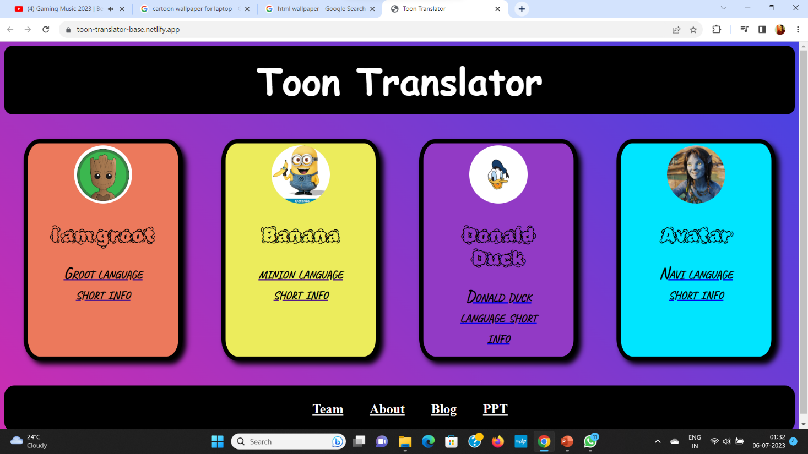
View of webapp
There are four tablets which enhances the
user experience and provide a range of
different cartoon translators.
1.GROOT TRANSLATOR - It translate English
to Groot language.
2.BANANA TRANSLATOR – It translate English
to Minion language.
3.AVATAR TRANSLATOR – It translate English to Navi language.
4.DOLAN DUCK TRANSLATOR – It translate English to Dolan language.
The standard format contains more options like Team, About and Blog. Which is present inside footer.
Standard format contains heading, footer and body.

Slide 8
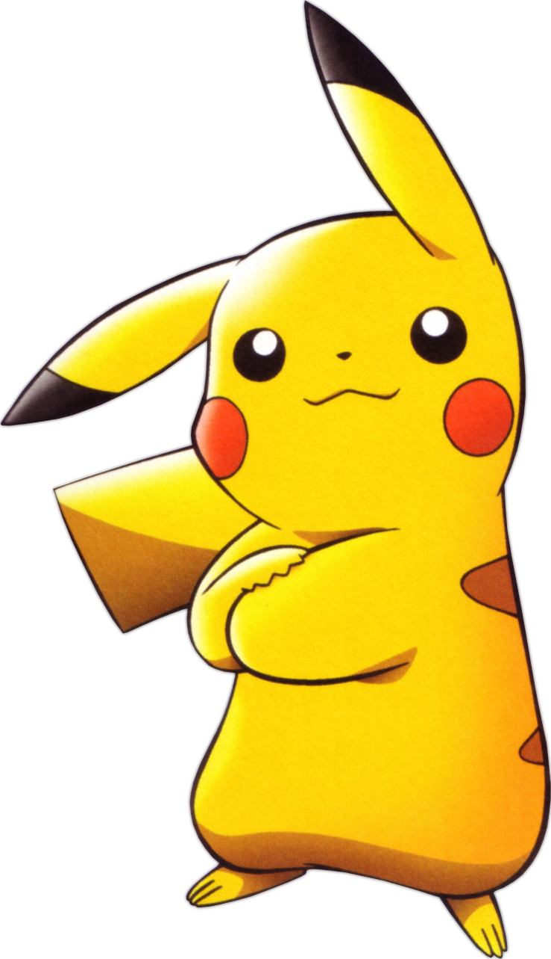
Why we choose cartoons?
1. Provide entertainment and joy.
2. Offer educational value for children.
3. Promote cultural representation and diversity.
4. Convey social commentary and raise awareness.
5. Stimulate imagination and creativity.

Slide 9
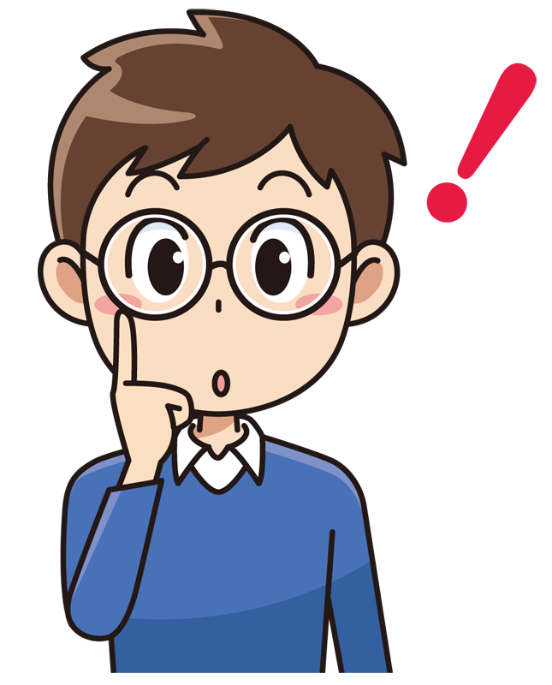
WHY TOON TRANSLATOR ?
For some people just to have fun while for some people to connect to their childhood and their favourite characters.
Cartoons bring positive benefits to child development in a variety linguistic, cognitive, social-emotional and physical levels.
Children improve their language, develop their sensory perceptions, and understand more emotions, discover the most important values and dance with their favourite characters.

Slide 10

How will TOON TRANSLATOR help you professionally ?
To write Tag Lines that Inspire Kids.
Explore new ideas to creativity.
Maybe you will able to create your own Language by Inspiration of Toon Translator.
Help to Develop your mind Creatively

Slide 11

THANK YOU

